Slide 1
Functions in Excel
Mathematical & Statistical, Financial, Logical, Information & Volatile

Slide 2
Mathematical & Statistical Functions
The SUM function is a very commonly used math function in Excel.
A basic formula example to add up a small number of cells is =A1+A2+A3+A4, but that method would be cumbersome if there were 100 cells to add up.
Use Excel's SUM function to total the values in a range of cells like this: SUM(A1:A100).
You can also use functions within functions. Consider the expression =ROUND(AVERAGE(A1:A100),1).
This expression would first compute the average of all the values from cell A1 through A100 and then round that result to 1 digit to the right of the decimal point

Slide 3
Some Statistical Functions
Average: To calculate the average of a range of cells, use the AVERAGE function.
Averageif: To average cells based on one criteria, use the AVERAGEIF function. For example, to calculate the average excluding zeros.
Median: To find the median (or middle number), use the MEDIAN function.
Mode: To find the most frequently occurring number, use the MODE function.
Standard Deviation: To calculate the standard deviation, use the STEDV function.
Min: To find the minimum value, use the MIN function.
Max: To find the maximum value, use the MAX function.
Large: To find the third largest number, use the following LARGE function.
Small: To find the second smallest number, use the following SMALL function.

Slide 4
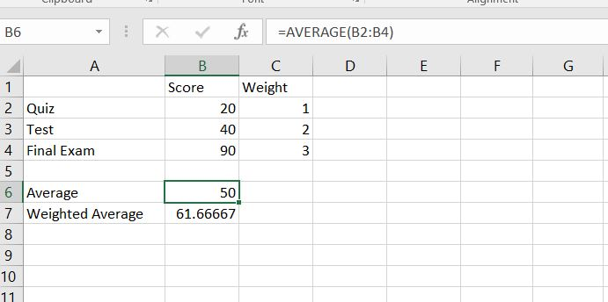
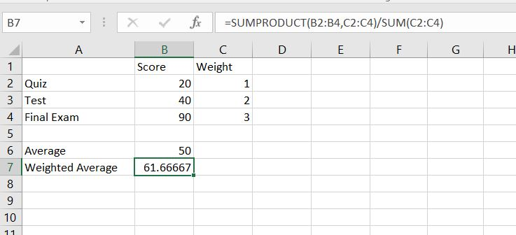
Statistical Functions(cont..)
Weighted Average: To calculate a weighted average in Excel, simply use the SUMPRODUCT and the SUM function.
Average function simply calculates the average of I dimensional array
Sum Product calculates weighted average of two dimensional data divided by sum.

Slide 5
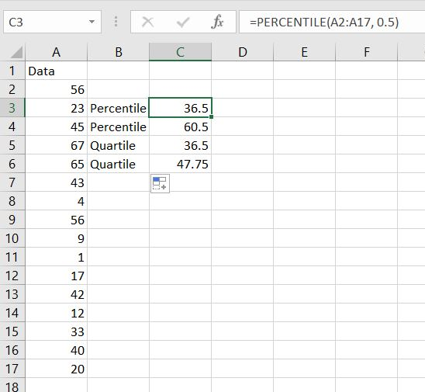
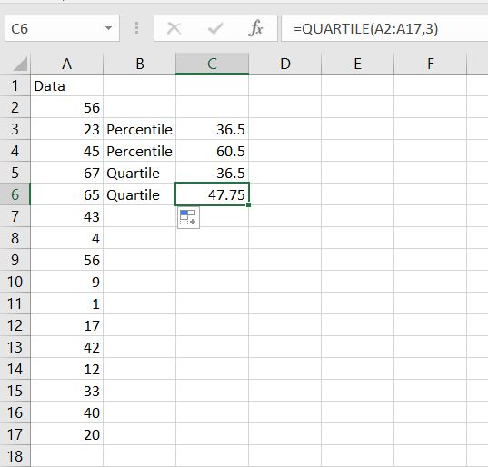
Percentiles & Quartiles
Use the PERCENTILE function shown below to calculate the 30th percentile. Excel returns the value 36.5. This means that 50% (8 out of 16) of the scores are lower or equal to 36.5
Use the QUARTILE function shown below to calculate the 3rd quartile. Excel returns the value 47.75. This means that 75% (12 out of 16) of the scores are lower or equal to 47.75

Slide 6
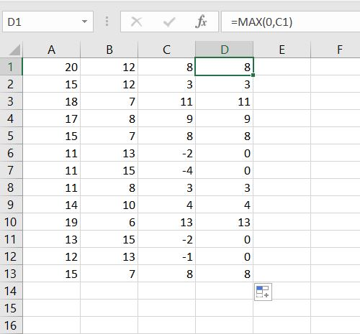
Change Negative Numbers to zeros
To change the negative numbers to zero but leave the positive numbers unchanged, instead of =A1-B1, use =MAX(0,A1-B1) or =MAX(0, C1) and drag the function down.
the MAX function returns the maximum of two values. If the result of the formula is negative, the function returns 0.

Slide 7
Financial Functions
Financial functions are very useful to calculate information about loans.
Common functions are FV, IPMT, PMT, PPMT and PV.
All these financial functions will use similar arguments that differ based upon which function you are using.
Think of the arguments as members of an equation
The arguments represent the values of the equation that are known and the function provides the solution for a single variable, or unknown, value

Slide 8
Use of Financial functions
The FV function calculates the future value of an investment based on periodic, constant payments and a constant interest rate per period.
The IPMT function provides the interest payment portion of the overall periodic loan payment.
The PMT function calculates the entire periodic payment of the loan.
The PPMT function calculates just the principal payment portion of the overall periodic payment.
The PV function calculates the present value of an investment.

Slide 9

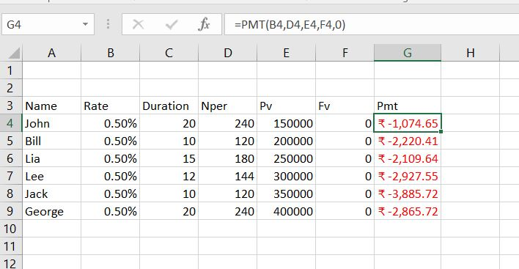
Example
To illustrate Excel's most popular financial functions, we consider a loan with monthly payments, an annual interest rate of 6%, a 20-year duration, a present value of $150,000 (amount borrowed) and a future value of 0 (that's what you hope to achieve when you pay off a loan).
We make monthly payments, so we use 6%/12 = 0.5% for Rate and 20*12 = 240 for Nper (total number of periods). If we make annual payments on the same loan, we use 6% for Rate and 20 for Nper.
when working with financial functions in Excel, always ask yourself the question, am I making a payment (negative) or am I receiving money (positive)? We pay off a loan of $150,000 (positive, we received that amount) and we make monthly payments of 1,074.65 (negative, we pay).

Slide 10
Logical Functions
A function that determines whether a condition is true or false is called a logical function.
Excel supports several logical functions such as AND, FALSE, IF, NOT, OR and TRUE.
A very common function is the IF function, which uses a logical test to determine whether an expression is true or false, and then returns one value if true or another value if false.
The logical test is constructed using a comparison operator that compares two expressions to determine if they are equal, not equal, if one is greater than the other, and so forth.
The comparison operators are =, >, >=, <, <=, and <>
You can also make comparisons with text strings. You must enclose text strings within quotation marks.

Slide 11
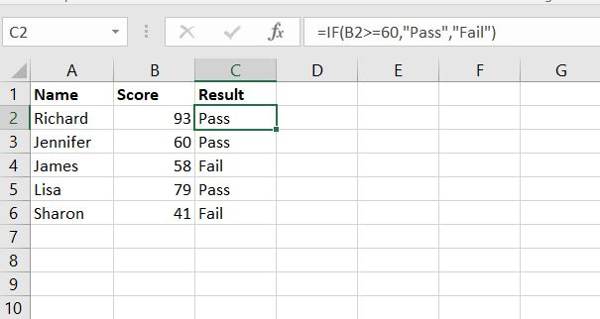
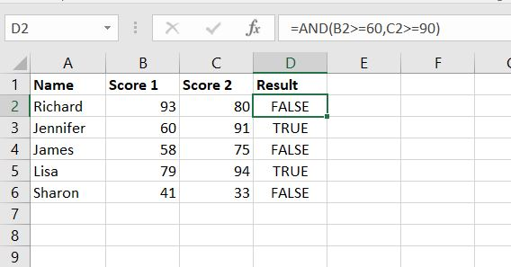
If & AND
The IF function checks whether a condition is met, and returns one value if true and another value if false.
The AND Function returns TRUE if all conditions are true and returns FALSE if any of the conditions are false.

Slide 12
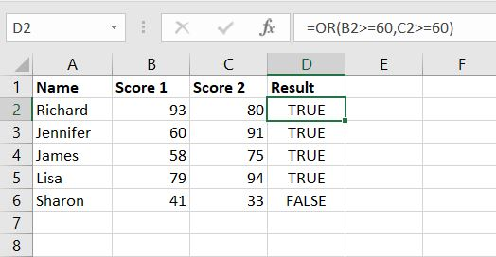
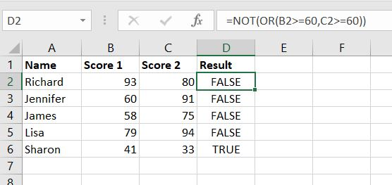
Or & Not
The OR function returns TRUE if any of the conditions are TRUE and returns FALSE if all conditions are false.
The NOT function changes TRUE to FALSE, and FALSE to TRUE.

Slide 13
Information Functions
CELL function: Returns information about the formatting, location, or contents of a cell
ISBLANK: Return TRUE if value is BLANK.
ISTEXT: Returns TRUE if value is text
ISEVEN: Returns TRUE if value is EVEN
ISFORMULA: Return TRUE if formula
ISNUMBER: Return TRUE if value is NUMBER
ISODD: RETURN TRUE if value is Odd
SHEET: Return sheet number

Slide 14
Volatile Functions
A Volatile Function is one that causes recalculation of the formula in the cell where it resides every time Excel recalculates. This occurs regardless of whether the precedent data and formulas on which the formula depends have changed, or whether the formula also contains non-volatile functions.
Some of Excel’s functions are obviously volatile: RAND(), NOW(), TODAY(), RANDBETWEEN(), CELL()
Dependents of Volatile functions.
Direct dependents of volatile functions are always recalculated: If A1 contains =NOW() and A2 contains =A1 and A3 contains =A2 then both A2 and A3 will be recalculated at each recalculation.
Indirect dependents of volatile functions are not always recalculated: If A1 contains =NOW(), and A2:A5 contain the numbers 2 to 5 then
=INDEX(A1:A5,1,1) is directly dependent on volatile cell A1 and will always be recalculated.
=INDEX(A1:A5,3,1) is only indirectly dependent on volatile cell A1 and will NOT always be recalculated, but it will be recalculated once if for example cell A5 is changed even though the answer will not change.

